Slide 1
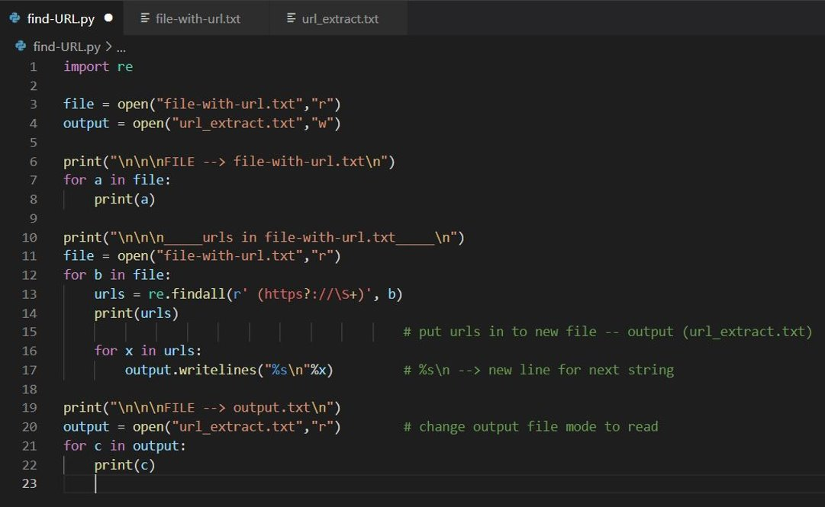
Extract URL From text file using Regular Expression

Slide 2
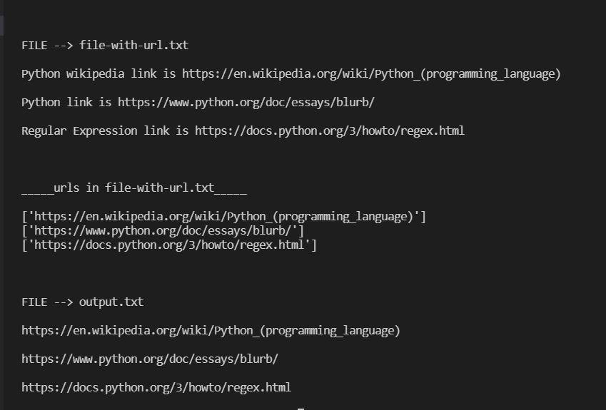
Output

